Slide 1
Section # 1
Introduction to Cloud Computing

Slide 2
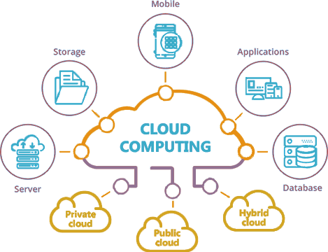
What is Cloud Computing ?

Slide 3
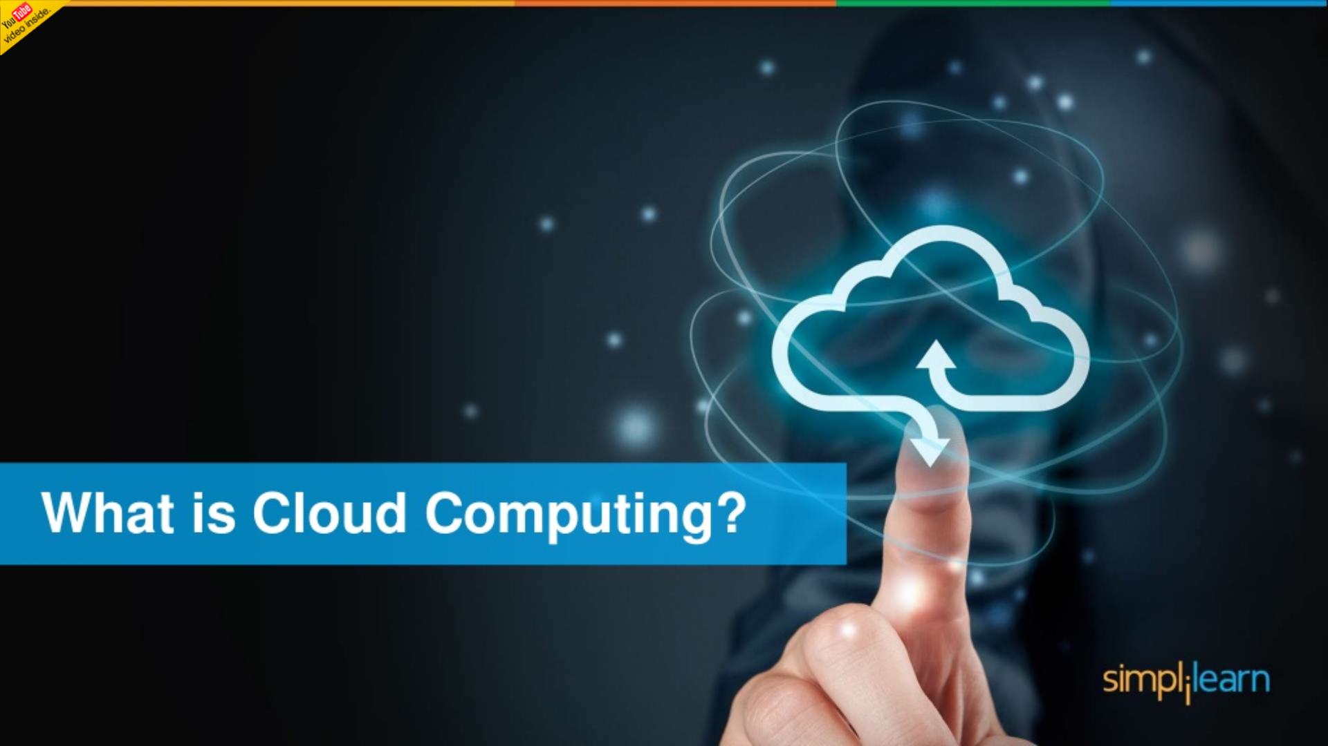

Slide 4
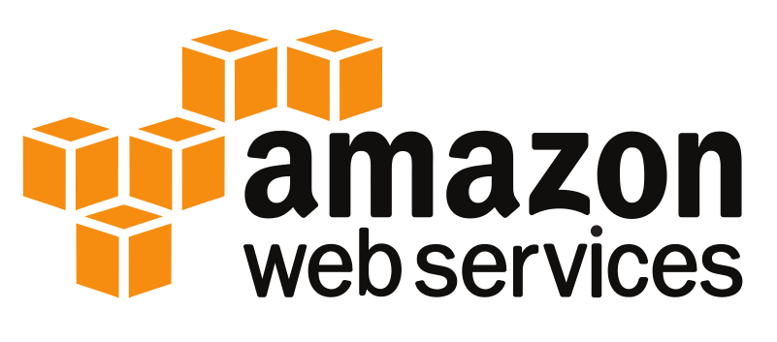
Welcome to this introductory course for Amazon Web Services.
The purpose of this course is to provide a high level introduction to Amazon Web Services using oversimplification of concepts for the purpose of providing a frame of reference for you to move forward.
This course is not going to teach you specifically how to use any specific AWS services and it's not going to get into any technical definitions or explanations.
What we're going to do here is again just to provide a high level introduction and I'm going to do that by really oversimplifying a lot of the concepts that we're going to talk about just so that you can have a frame of reference to move on with.

Slide 5
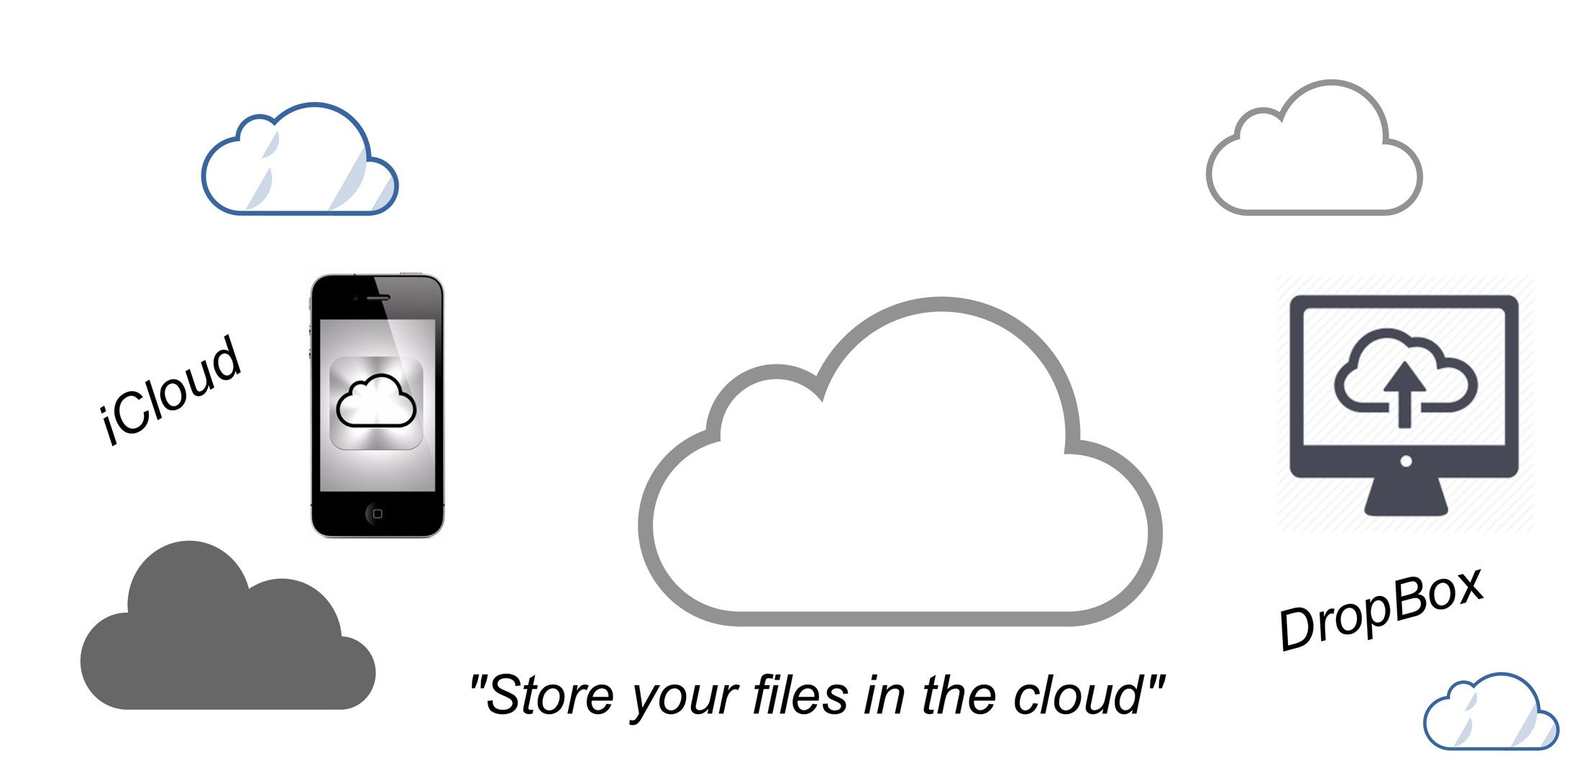
What is Cloud
Many of you are probably somewhat familiar with these icons right.
You see them on your phone maybe you see them on your desktop
You hear terms like iCloud or Dropbox or you hear sales pitches which is something like store your files in the cloud

Slide 6
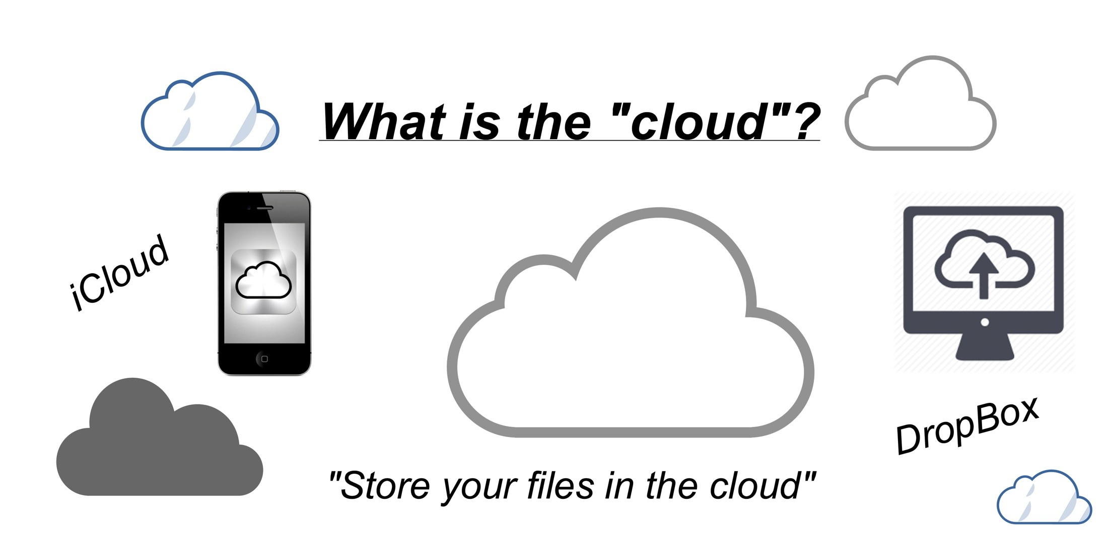
What is Cloud

Slide 7
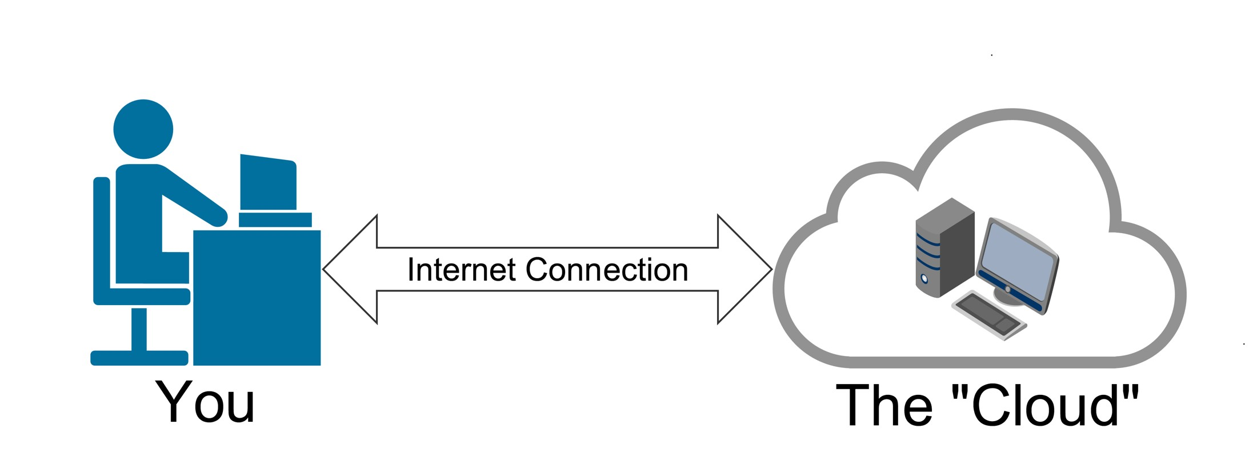
What is Cloud
Think about it really as just a computer just like a computer that you have on your desktop or your phone.
It's just a computer that's somewhere else.
it's a computer that is somewhere else that you are in some way utilizing whether you're utilizing its storage or its processing power.
You're utilizing that computer that is somewhere else in some fashion obviously using an internet connection.

Slide 8
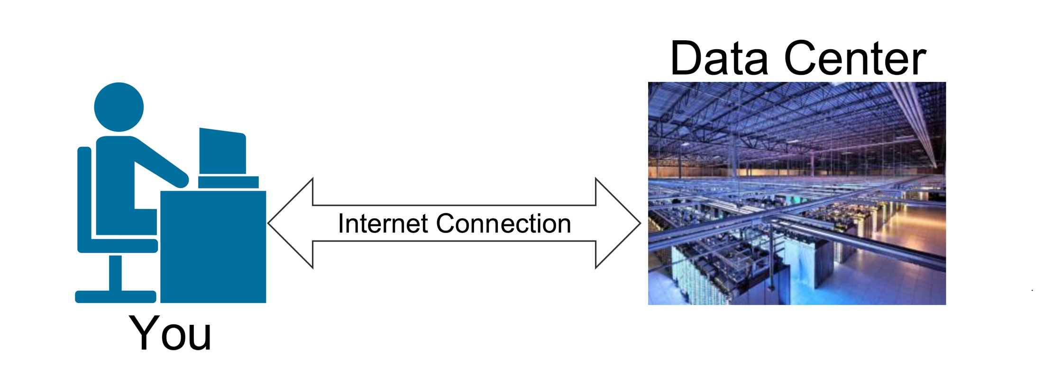
What is Cloud
Now in reality it's not just one single computer.
It's more of something like this a data center which you may have seen pictures of in the past where there's just rows and rows and rows of server computers that you are utilizing.

Slide 9
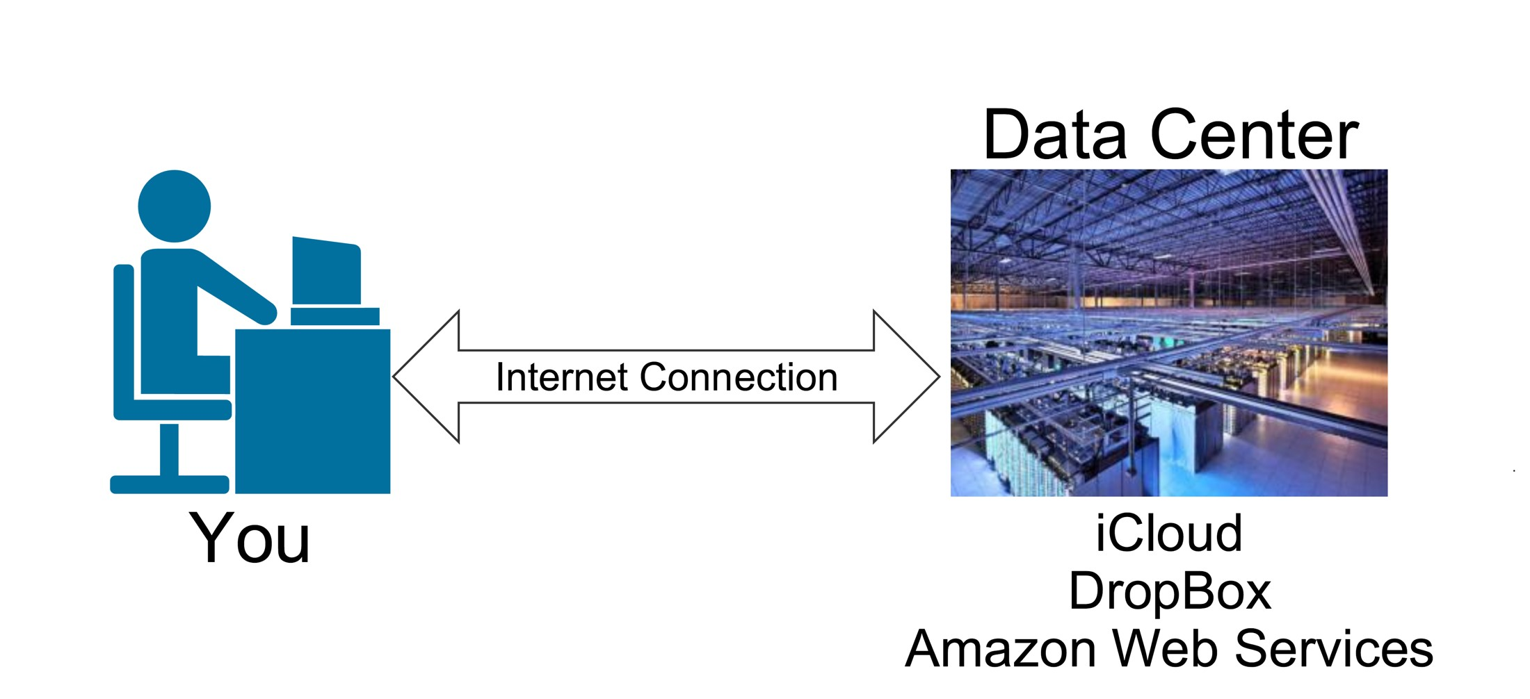
What is Cloud
Companies like iCloud Dropbox or Amazon Web Services your files or your pictures your documents whatever your story are not just going up into the cloud into this magical mystery box
Your files are actually being stored on a server computer which is in one of these racks as they’re called in one of these data centers which now there are many of all around the world.

Slide 10
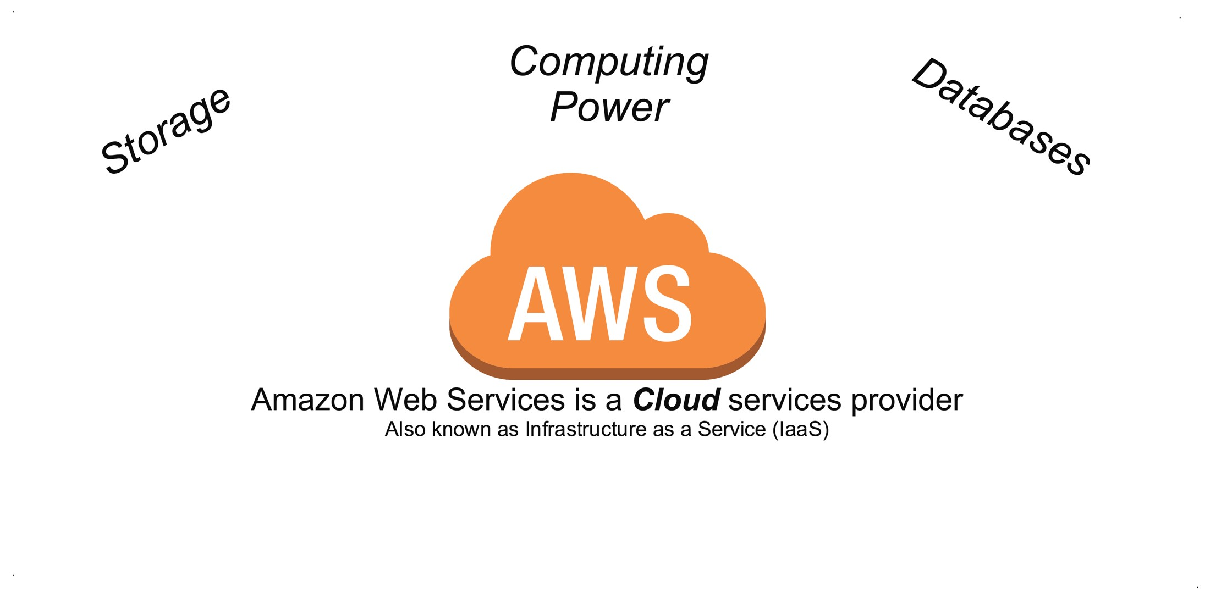
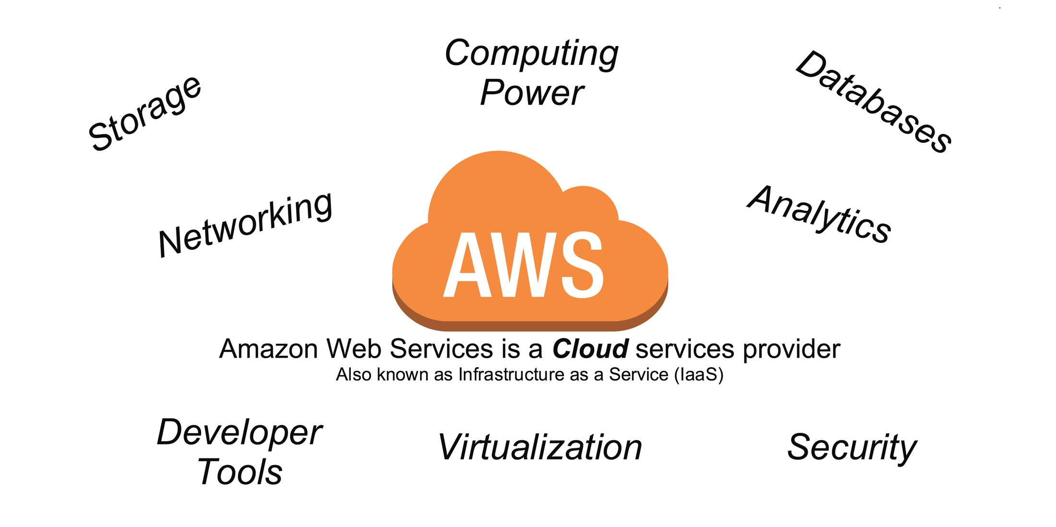
What is Cloud
Amazon Web Services is a cloud services provider and that is also known as infrastructure as a service or IAAS.
Commonly people who refer to Closer fighters they think about storage computing power databases
Amazon Web Services offers a lot more in terms of networking analytics developer tools virtualization security.

Slide 11
Why do individuals and companies use AWS?
What are the benefits?
How is the “Cloud” different from what has been used in the past?

Slide 12
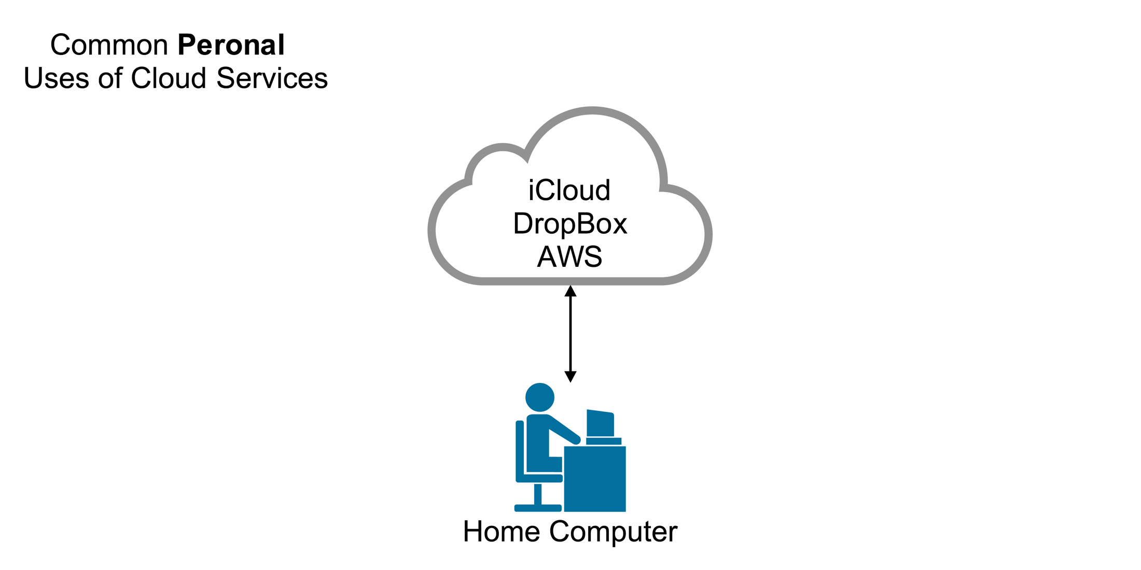
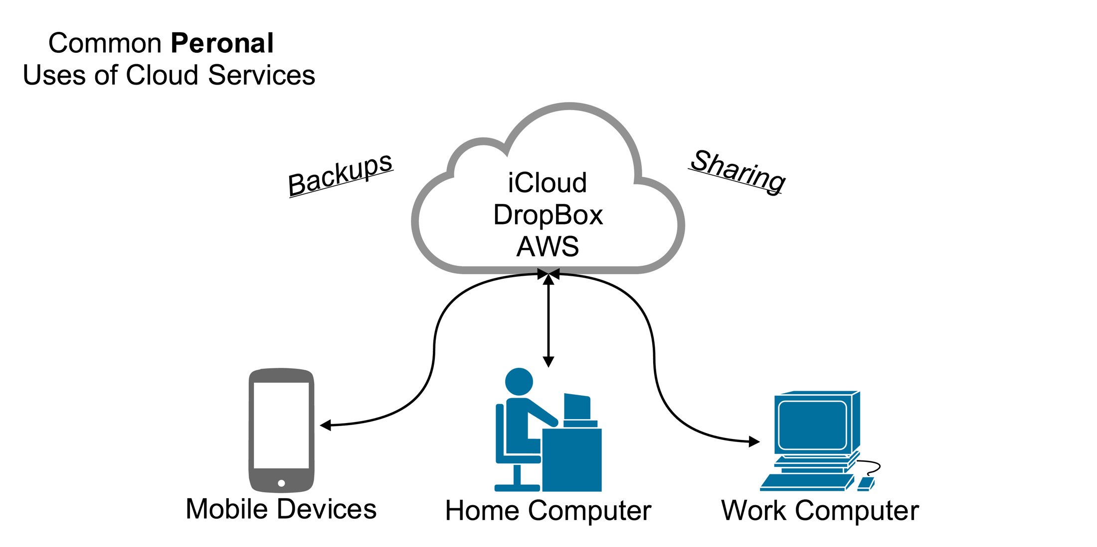
Backups & Sharing
Some common personally uses of cloud services to think about iCloud Dropbox or AWS to a certain extent
You may use iCloud or Dropbox to store videos pictures or some personal files that you may have.
And what cloud allows you to do specifically for an individual is backups and sharing.

Slide 13
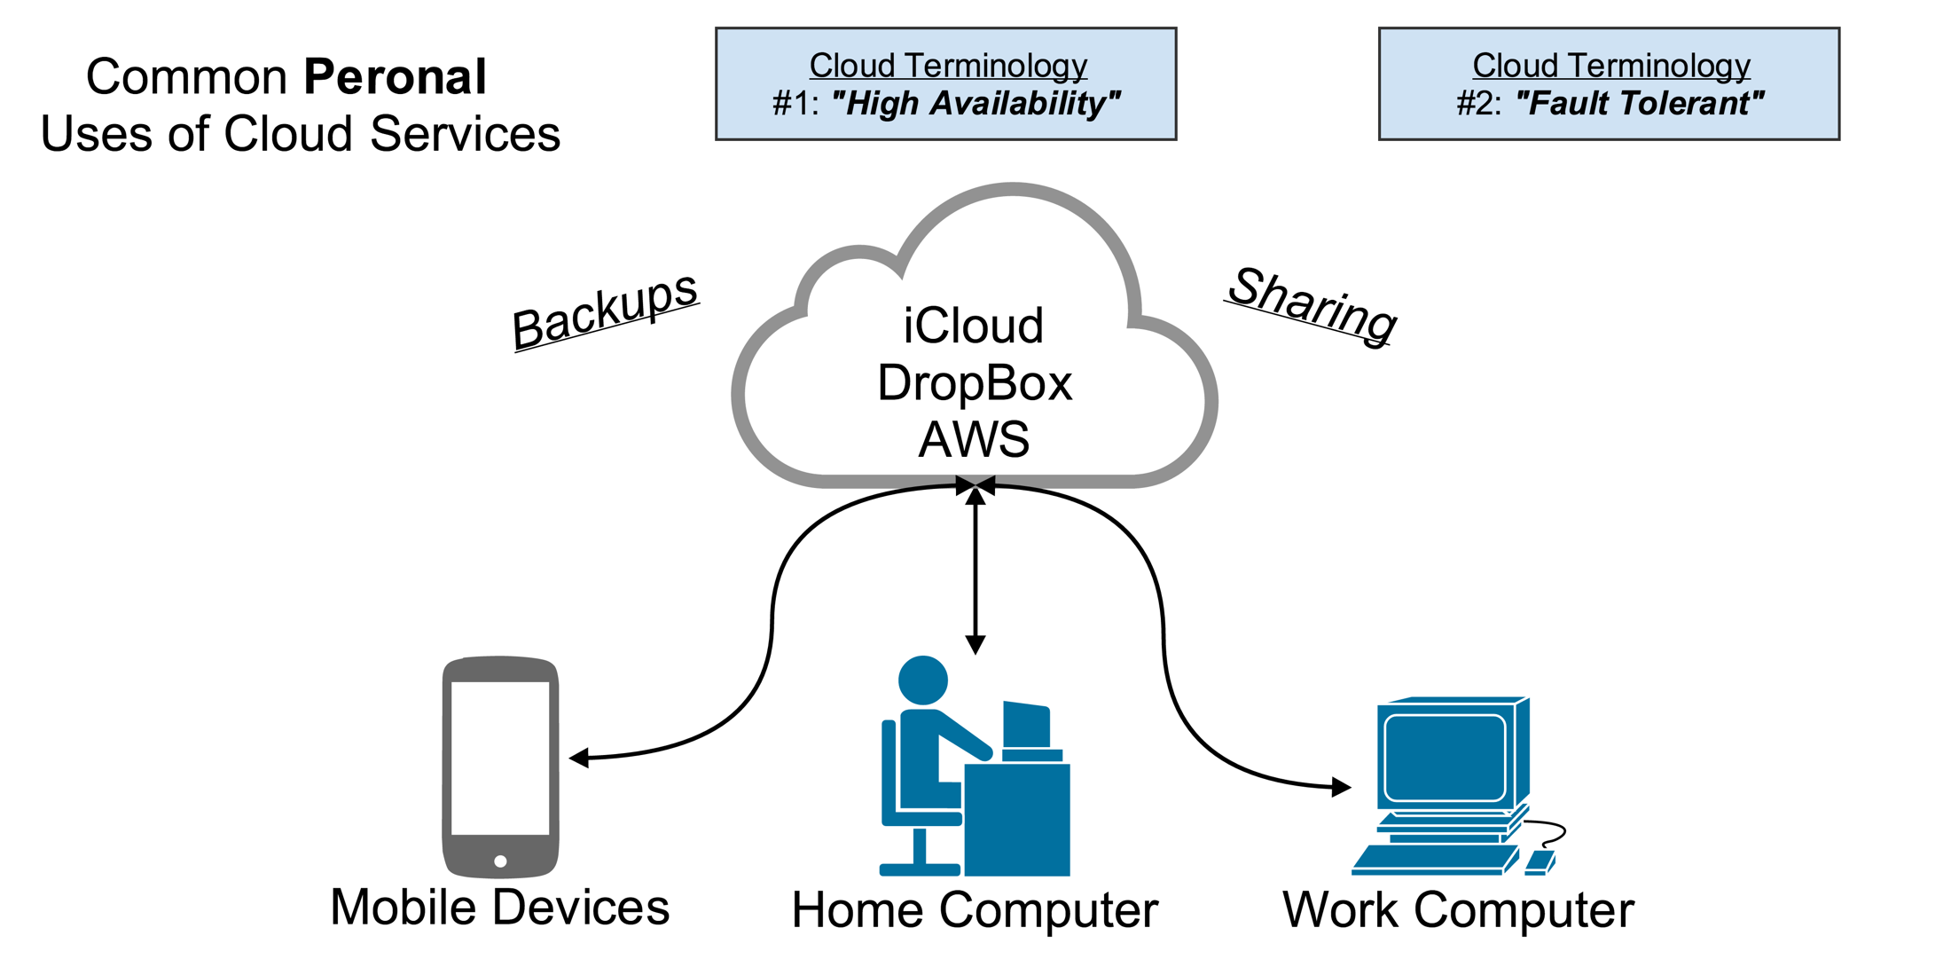
H.A & Fault Tolerant
If you put a file up into the cloud you can access it from any type of device or any type of computer as long as it has an internet connection.
So that makes that file highly available, You can access it from anywhere.
If you have a file only on your home computer and your home hard drive fails then it's gone.
But if the file is up in the cloud and it's backed up on multiple services then there will be another copy for you to access.
So if there is a fault in the system you will still always have the ability to retrieve that file.

Slide 14
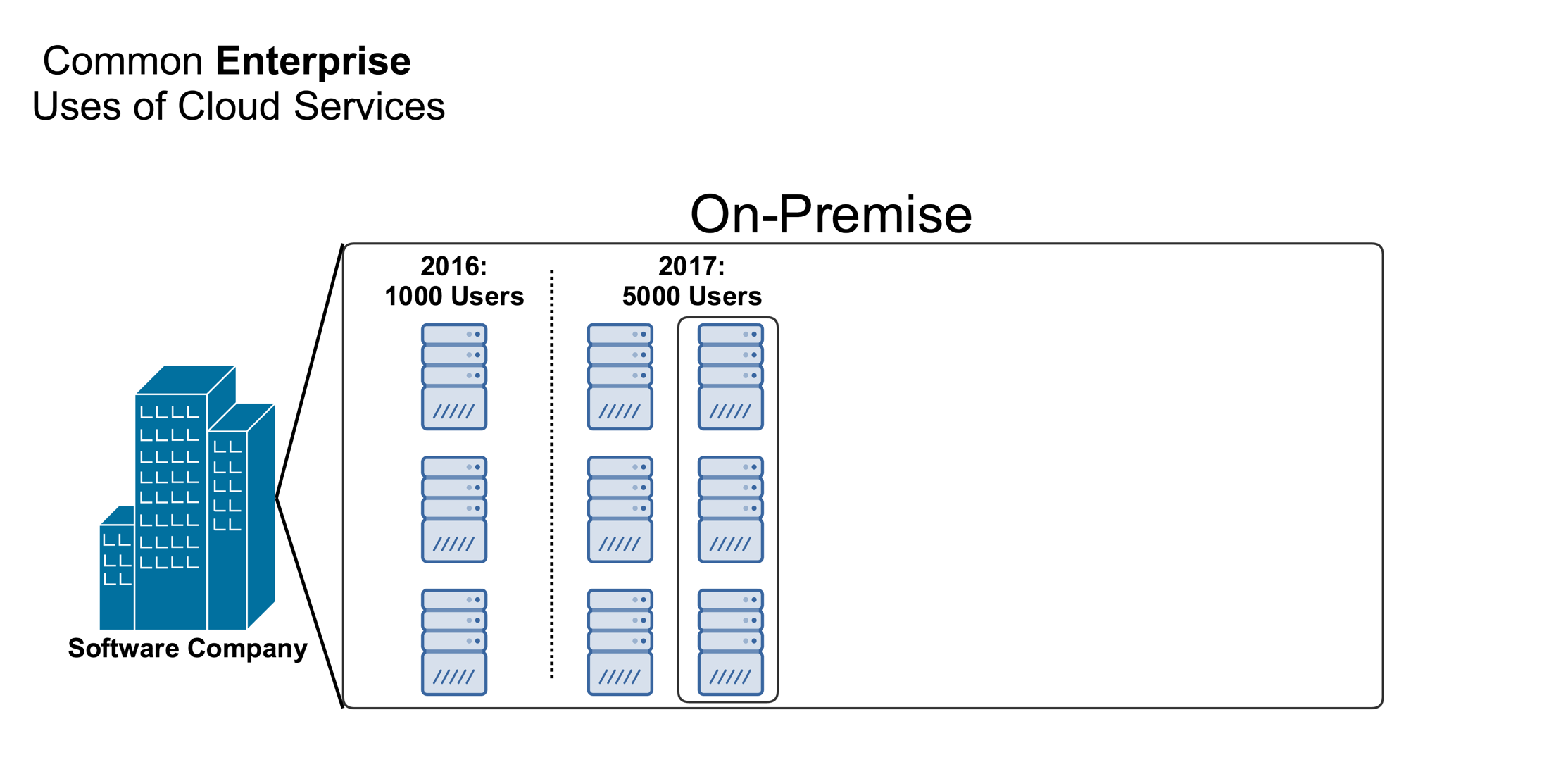
On Premise
Company have server computers which are storing their data handling their code or when customers use their software they're accessing the software on the company's servers.
let's say that it is 2016 and this company currently has about 1000 users which takes three servers to power the software for those 1000 users.
let's say we're looking forward to 2017 and this company is estimating that in 2017 they're going to have growth and they're going to have 5000 users.

Slide 15
Challenges
Now if they're going to have 5000 users the three servers that they originally had would not be enough.
They're going to add an additional 3 servers to hand or the load of having more users.
But in order to add three additional servers to their on premise data center they're going to have to one have the size and the space to put these servers into their data center.
You're also then going to have to research what type of servers they need they're going to have to buy them that's going to cost generally a significant amount of money.
They're going to have to wait for delivery which can be anywhere between a week to several weeks for servers.
They're then going to have to set them up test them install operating system software get them all up and running back and take a lot of time.

Slide 16
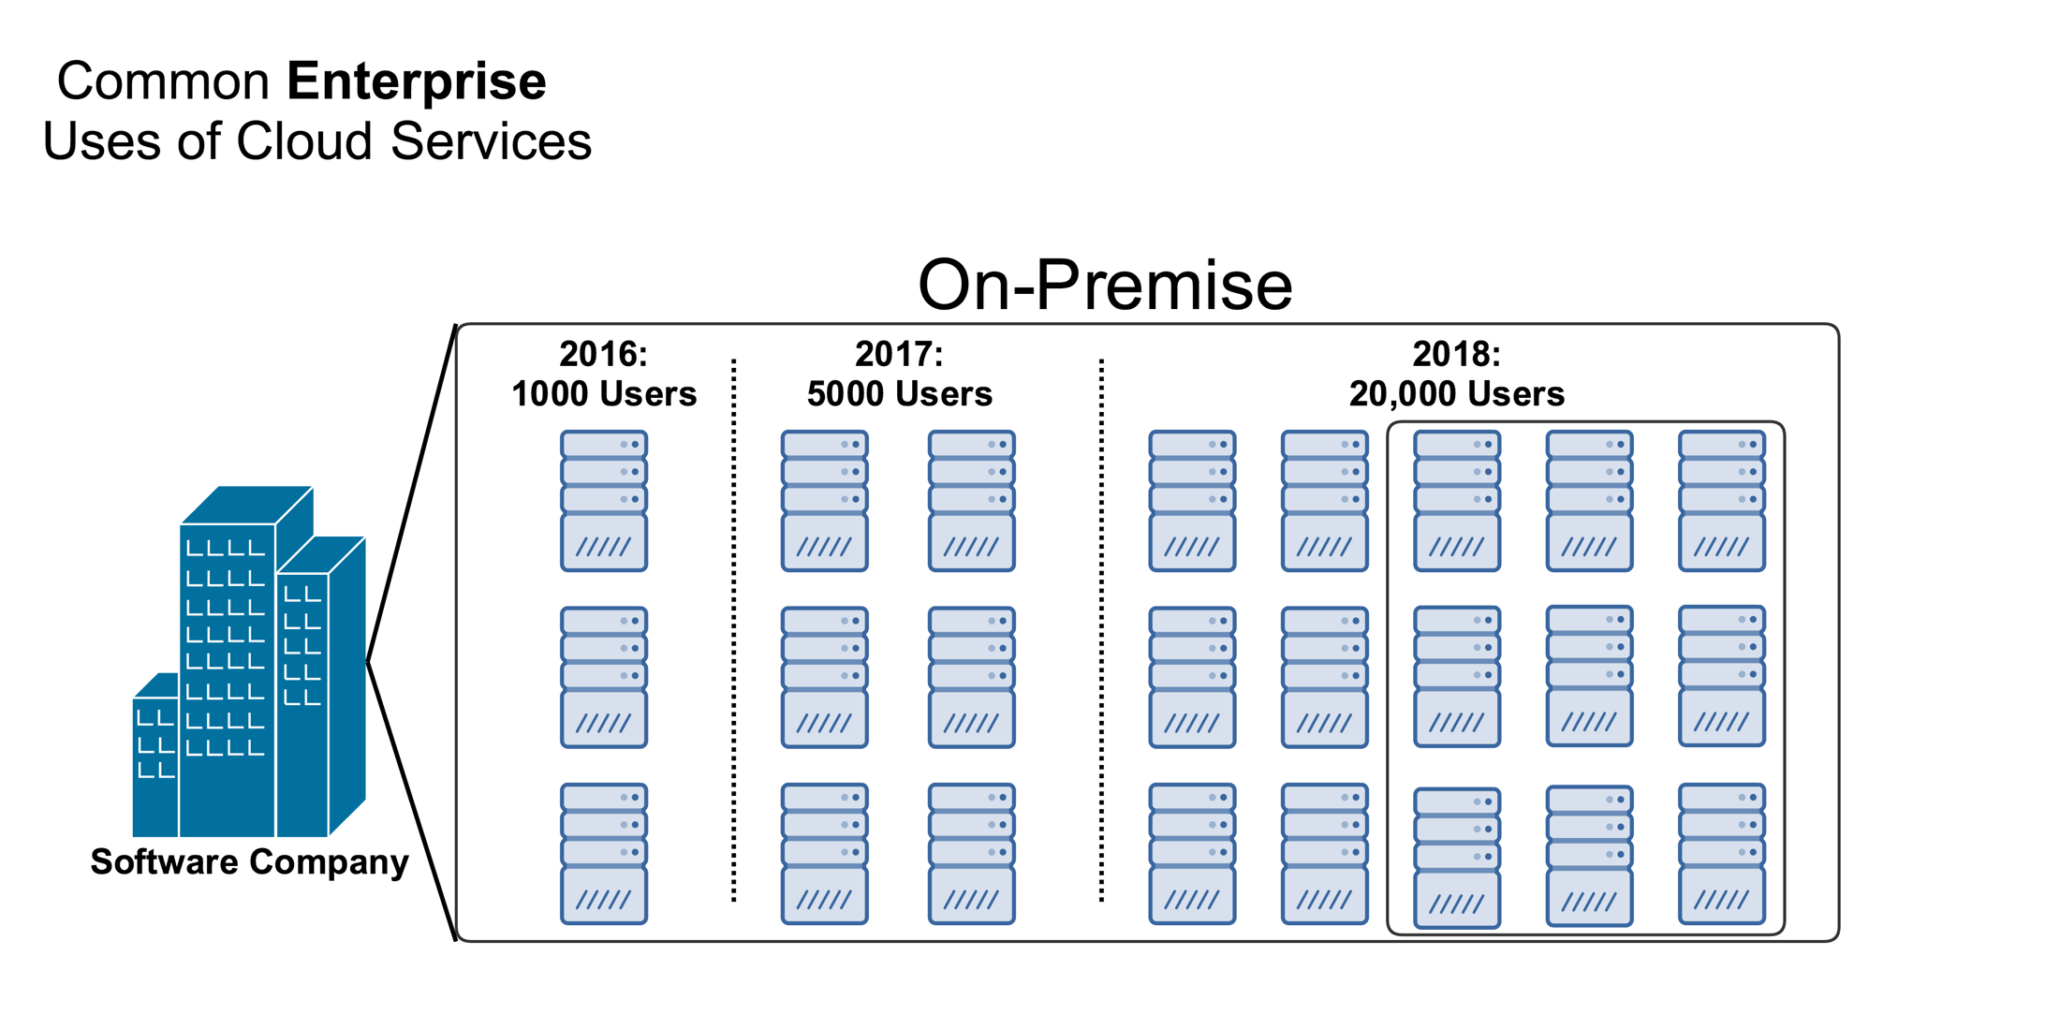
On Premise
let's assume that their estimates were right.
And in 2017 they increased their user base to about 5000 users.
And the six servers are currently working for them in the user base that they have.
Now let's look forward to 2018 and let's say that they're now expecting 20000 users estimating 20000 users in 2018 as their company and user base is growing.
Now they would have to add an additional 12 servers.

Slide 17
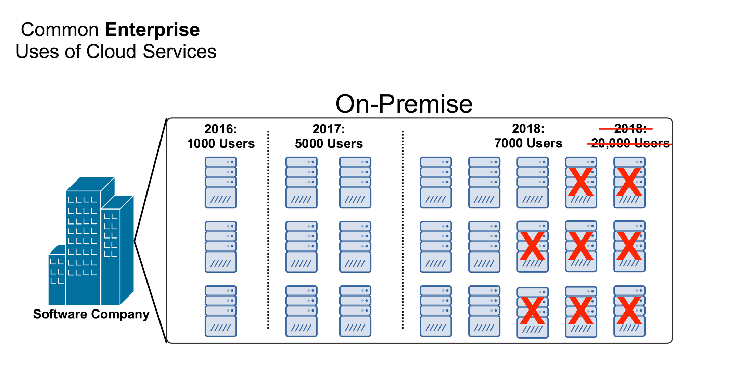
On Premise
what if in 2018 they were wrong and they didn't get 20000 users but they only topped out at 7000 users.
Now a whole segment of the servers that they just purchased for 2018 aren't being used.
It was a tremendous waste of resources a tremendous waste of money for something that is not being used
They would have to sell the servers or just let them sit there until the user base were to increase.

Slide 18
On Premise
Companies specifically a growing company spending the tens of thousands of dollars on these servers may have been a big investment.
If they didn't get the user base to back that up it could be a major loss for the company.
This is a problem with on premise data centers that something like cloud services seeks to solve.

Slide 19
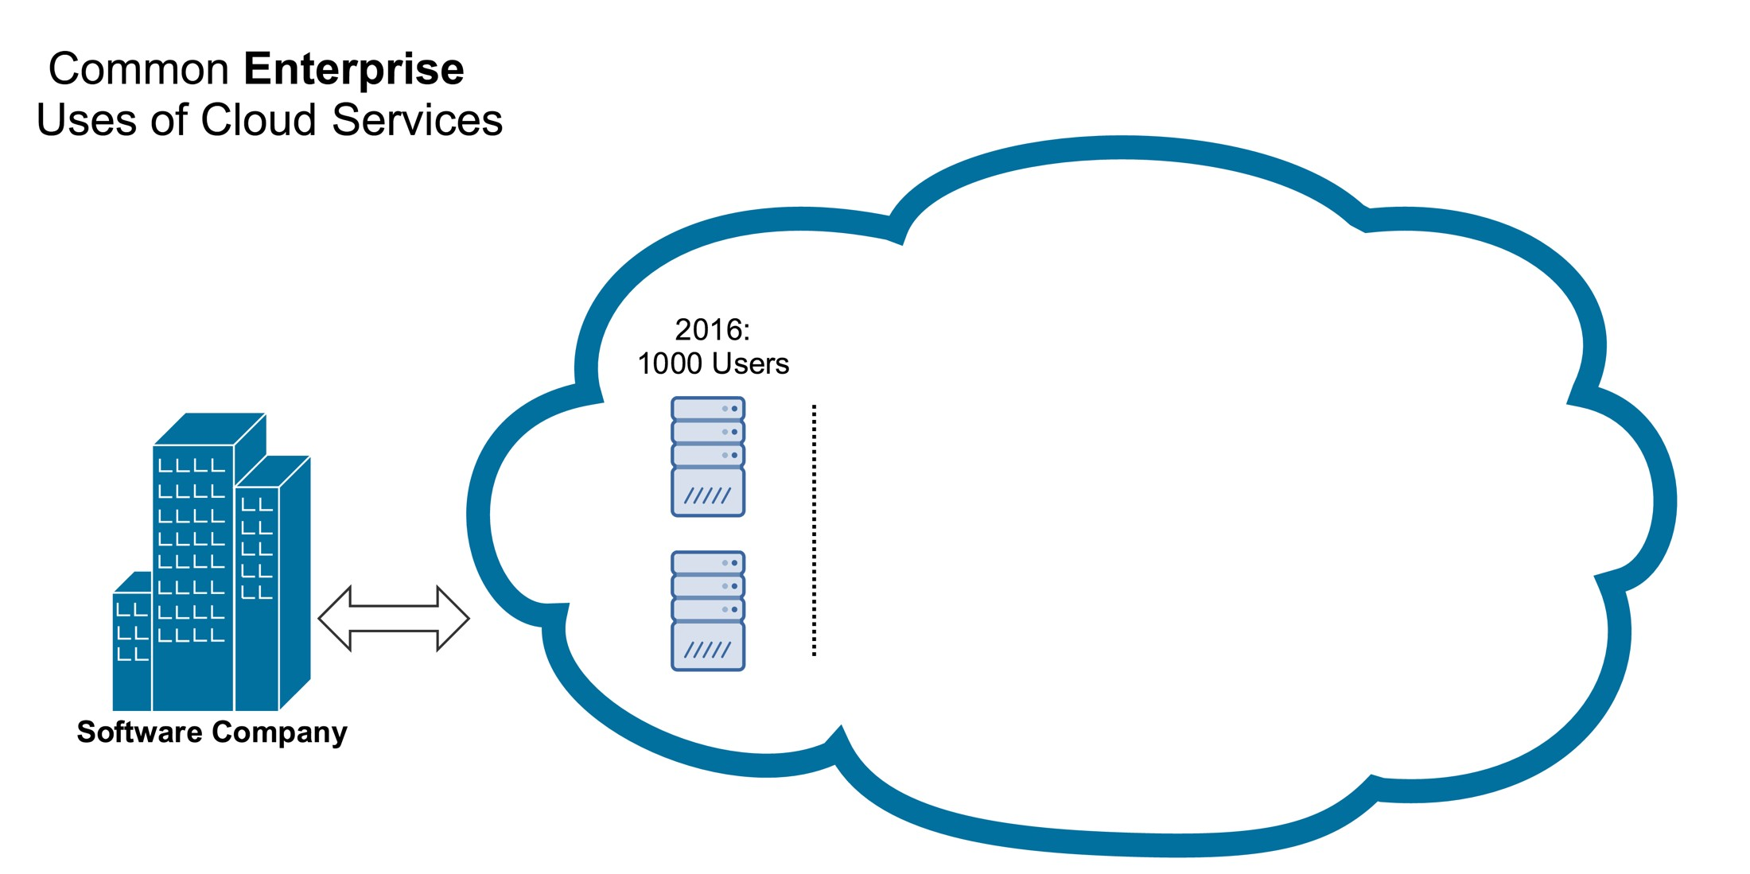
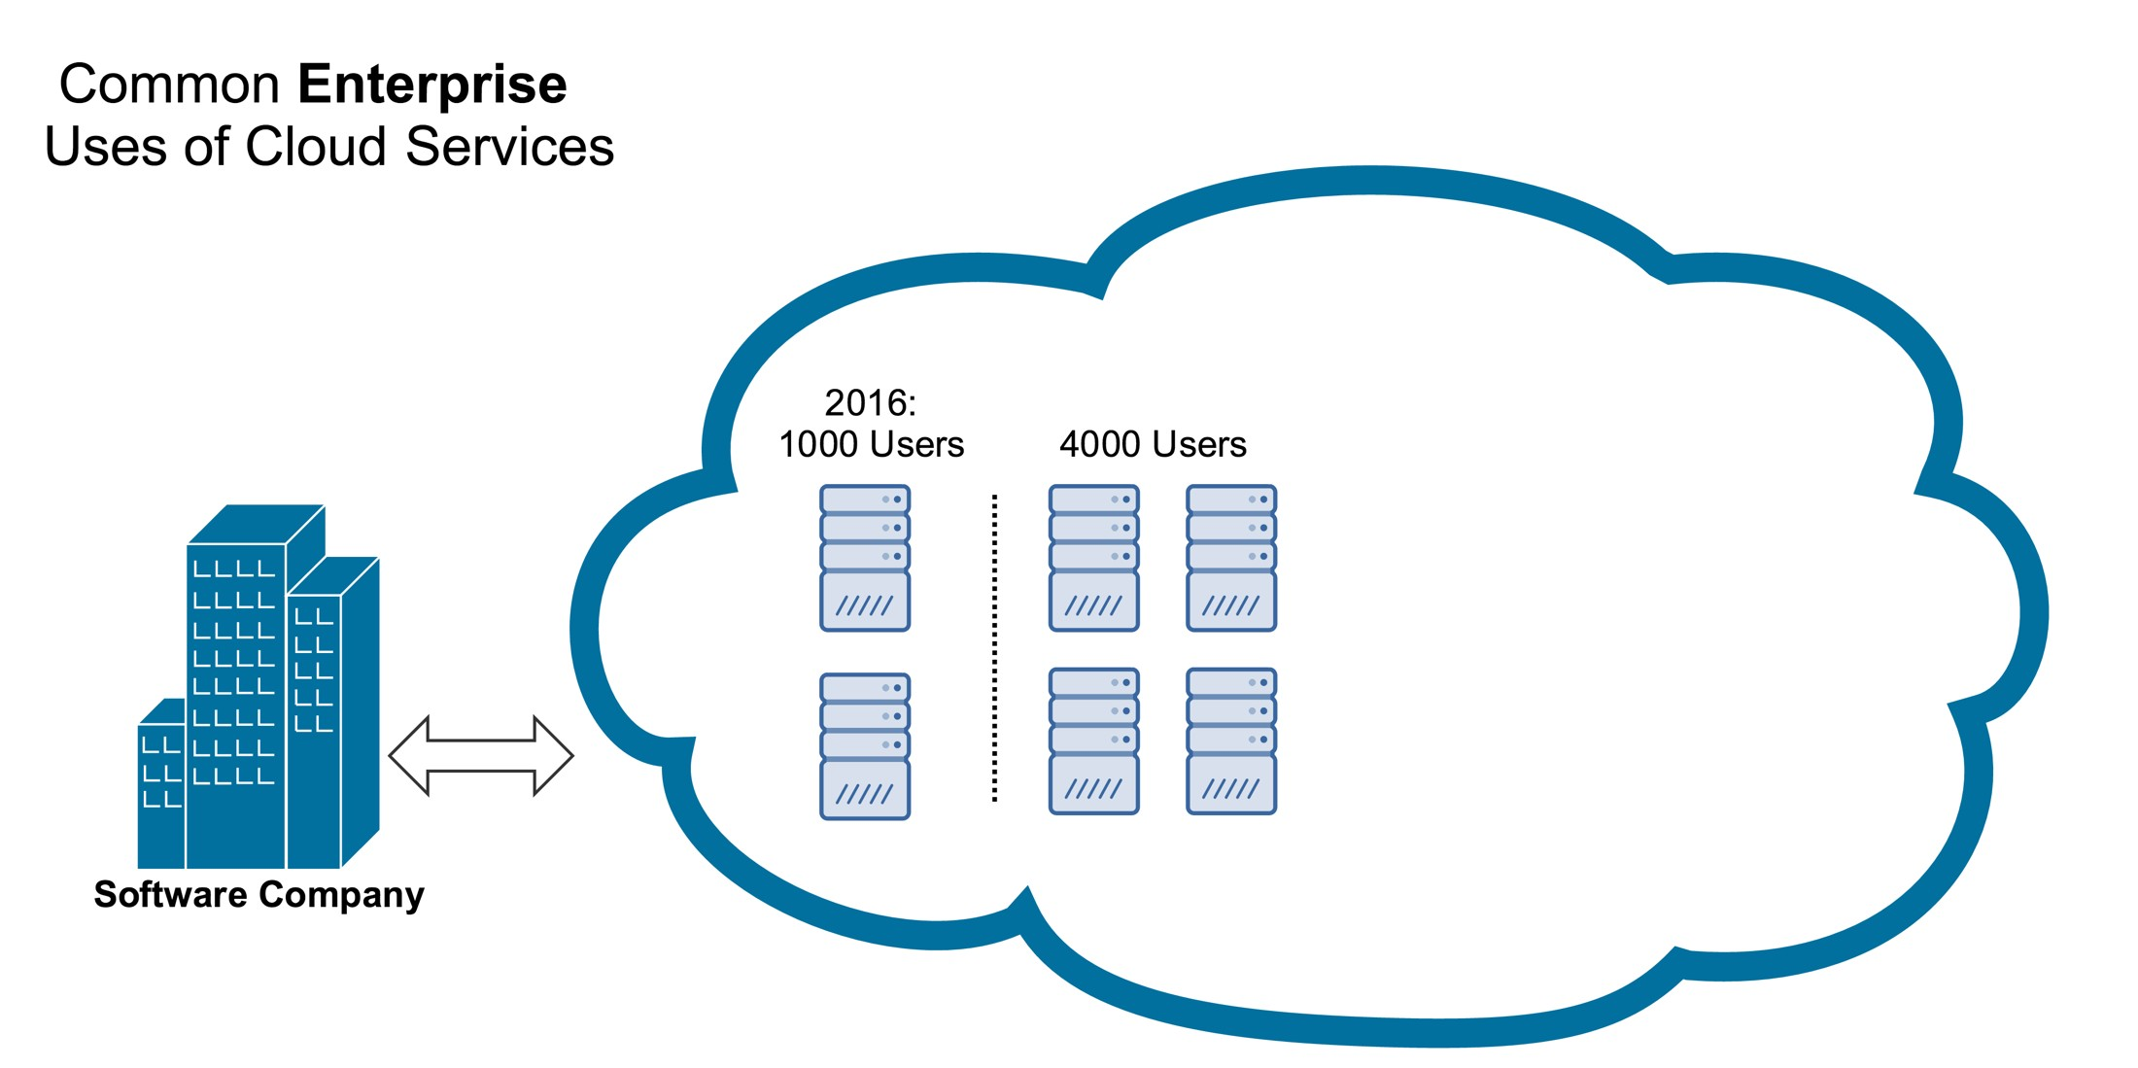
Cloud Service
If the company is using a cloud service provider such as AWS, in 2016 again this company currently has a thousand users
let's say for this example that they have two servers that they currently have provisioned and are using in the cloud.
As the company grows at this timetable doesn't matter anymore because the company no longer has to project or estimate future growth.
Naturally as the user base increases say from 1000 to 4000 cloud service providers as user base grows automatically and instantly add additional servers so the company didn't have to estimate growth.

Slide 20
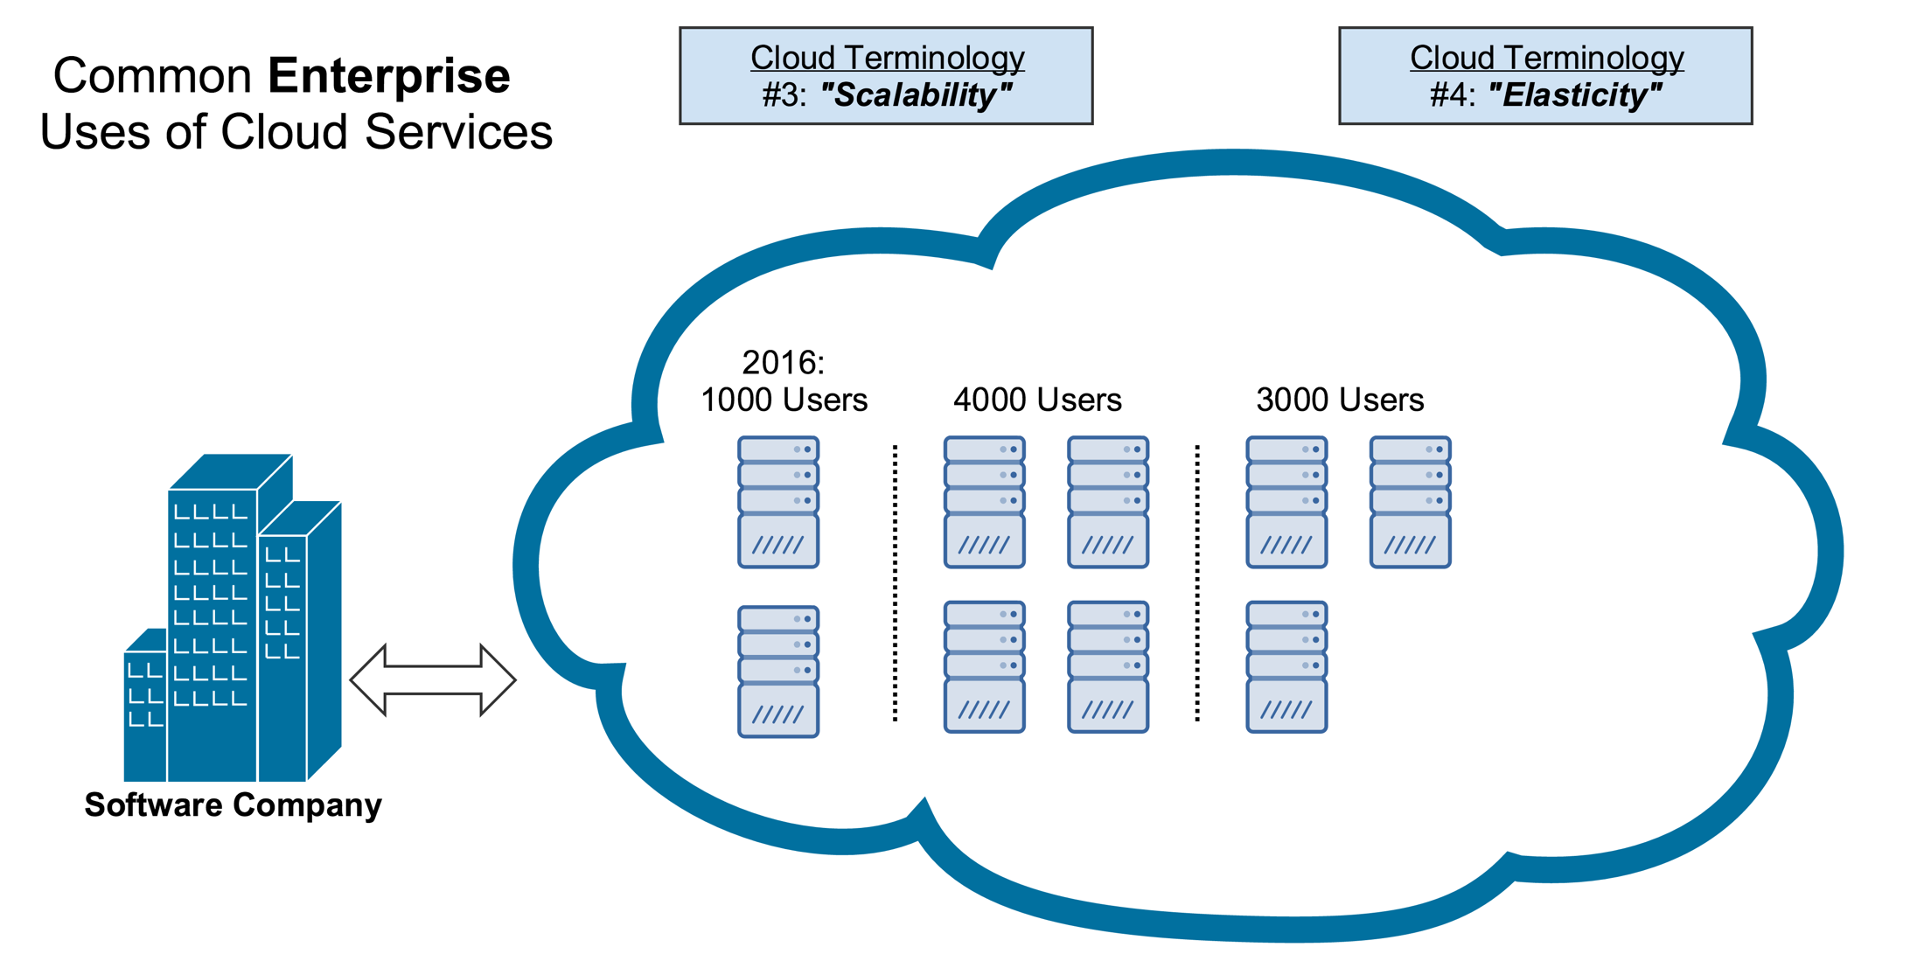
Cloud Service
If the user base dropped from 4000 to 3000 the cloud service provider simply just de-commissioned that server and this particular company is no longer being charged for it.
Using a cloud service provider you're only leasing hardware and on an on demand basis meaning that as your user base grows you can add more.
And as it shrinks you can pare those down and no longer pay for them.
Scalability is that as user base grows you have the ability to quickly and easily add more servers so you can scale up extremely easily.
Elasticity means that you can grow but you can also shrink.
Think about Elasticity right a rubber band.

Slide 21
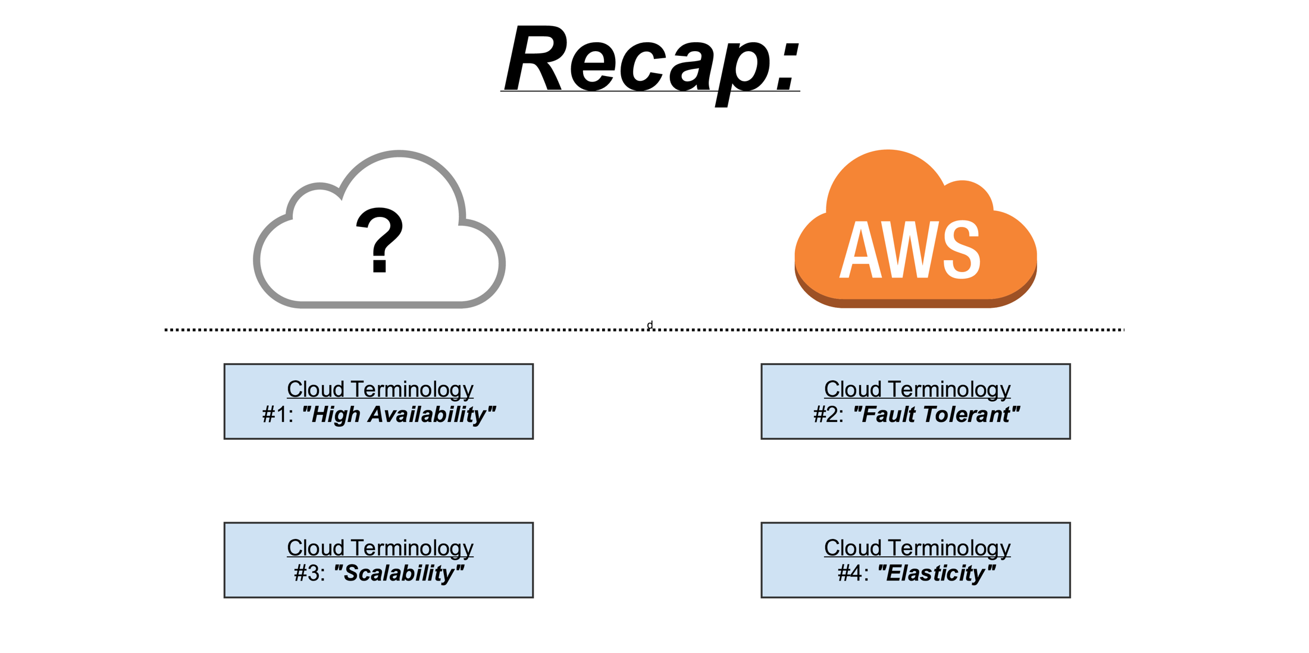
Conclusion
Cloud is just a computer somewhere else that you are using in some fashion an AWS is a cloud services provider.
High Availability: Think about your files are available all the time and from any device that you want with fault tolerant.
Fault Tolerant: Think about if something goes wrong with hard drive or your Computer goes down if there is backup that no matter what goes wrong you'll still be able to access your files and your files will never be deleted.
Scalability & Elasticity: Think about the ability to quickly grow and shrink on demand based on your needs.
Four terms listed here are the major reasons and advantages why both personal users and enterprise users love cloud services.

